Slide 1
SurfScanner
By Luke Smith

Slide 2
About
SurfScanner is the perfect platform for surfers all over the world, giving on point predictions, based on historical data.

Slide 3
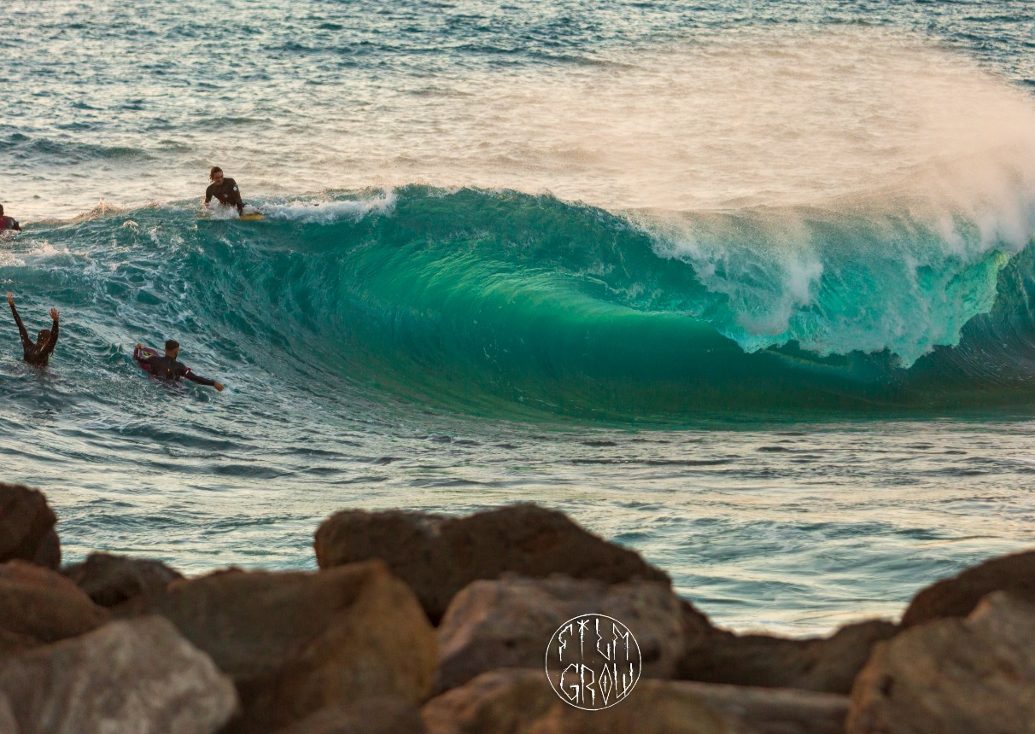
Why this project?

Slide 4
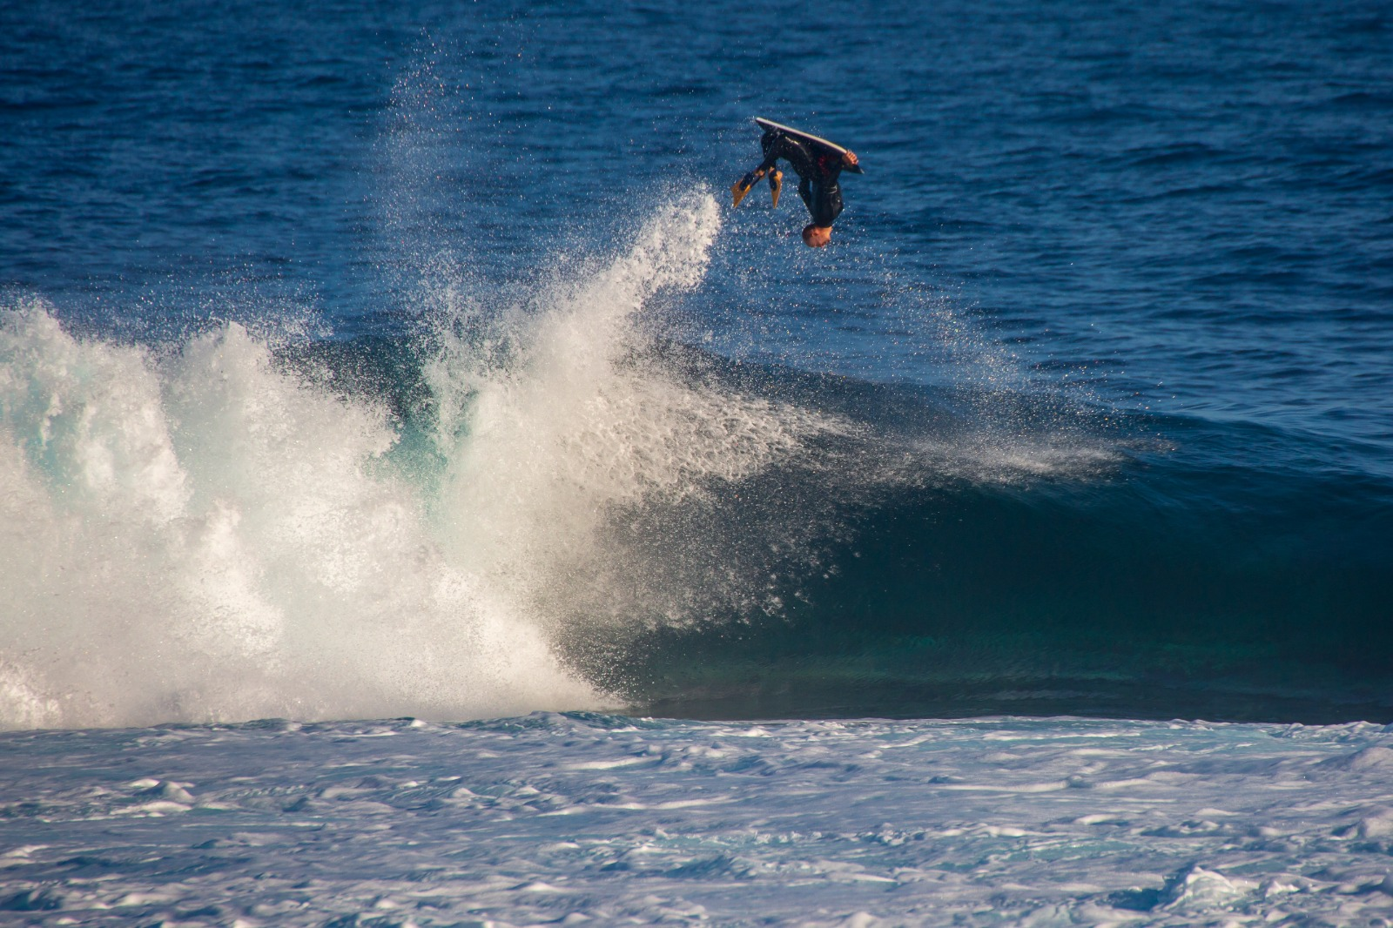
How did I get to the final product?
Webscrapping
Visual analysis
ML models were deployed

Slide 5
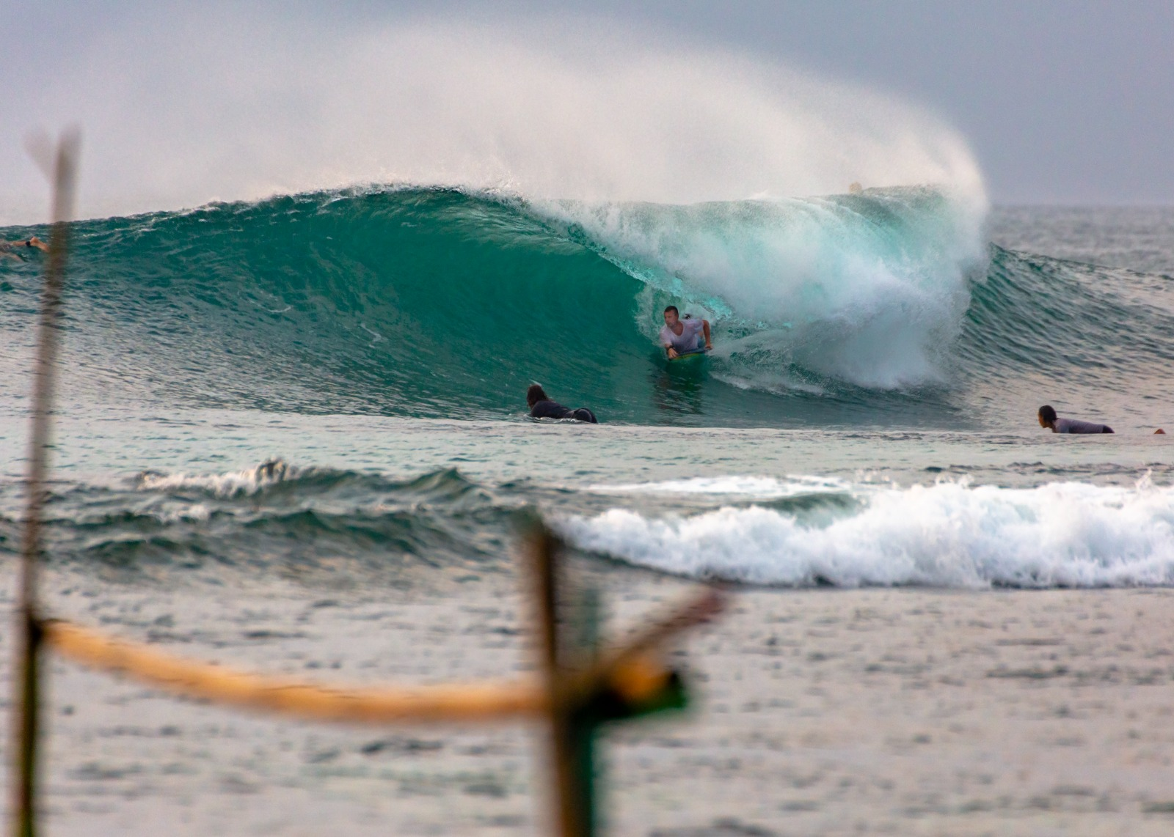
​
Graphical analysis

Slide 6
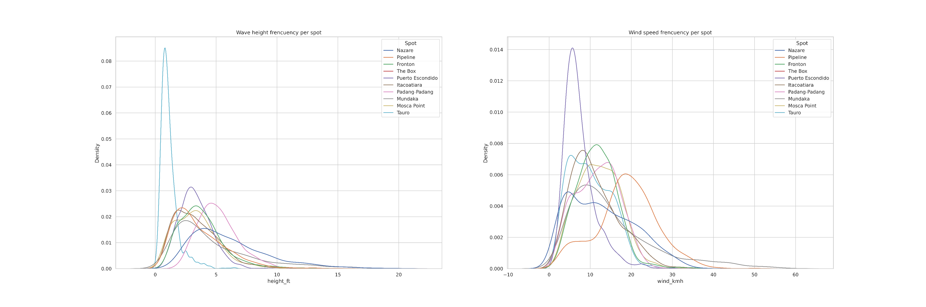
Wave & Wind frequency

Slide 7
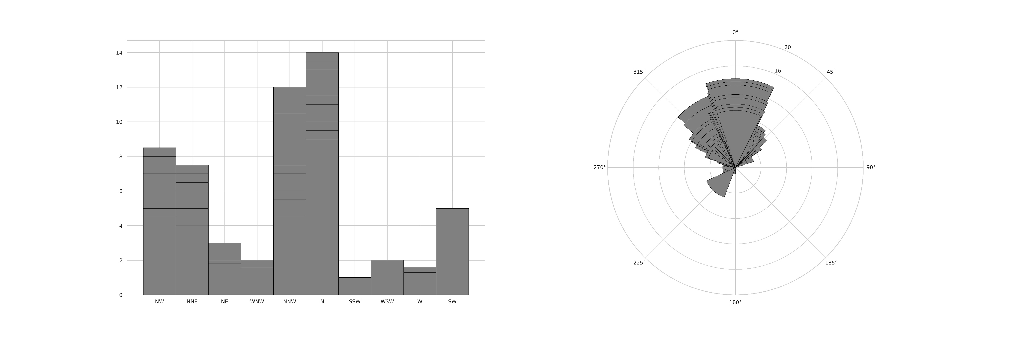
El Frontón

Slide 8
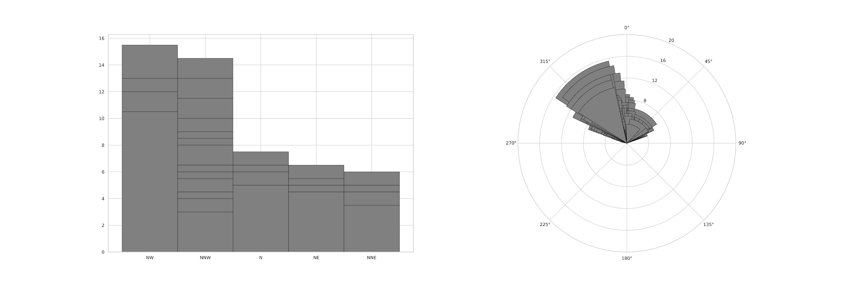
Pipeline

Slide 9
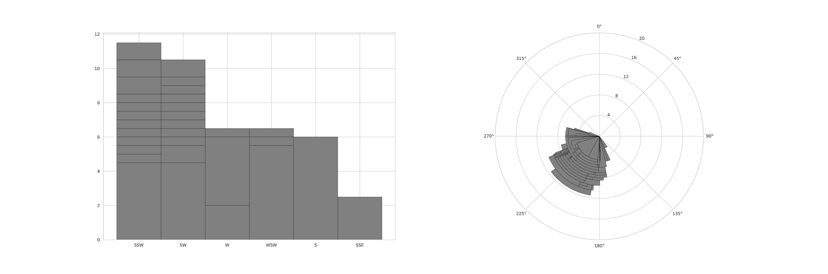
Padang-padang

Slide 10
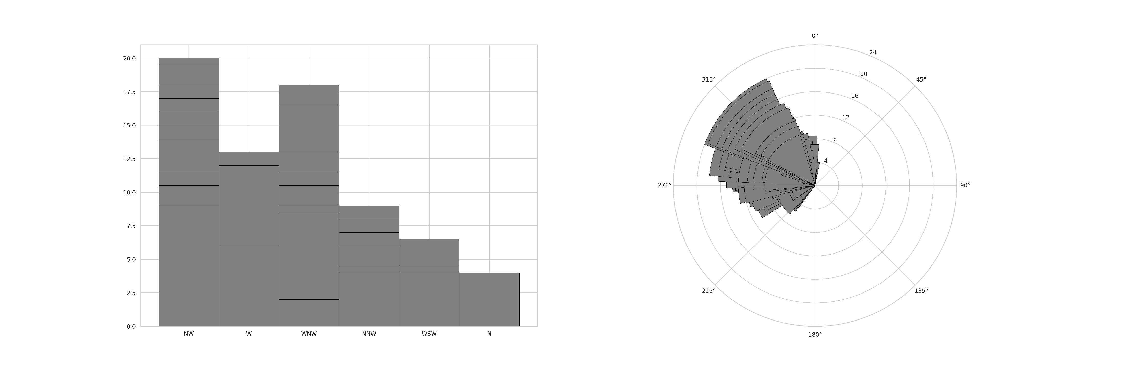
The Box

Slide 11
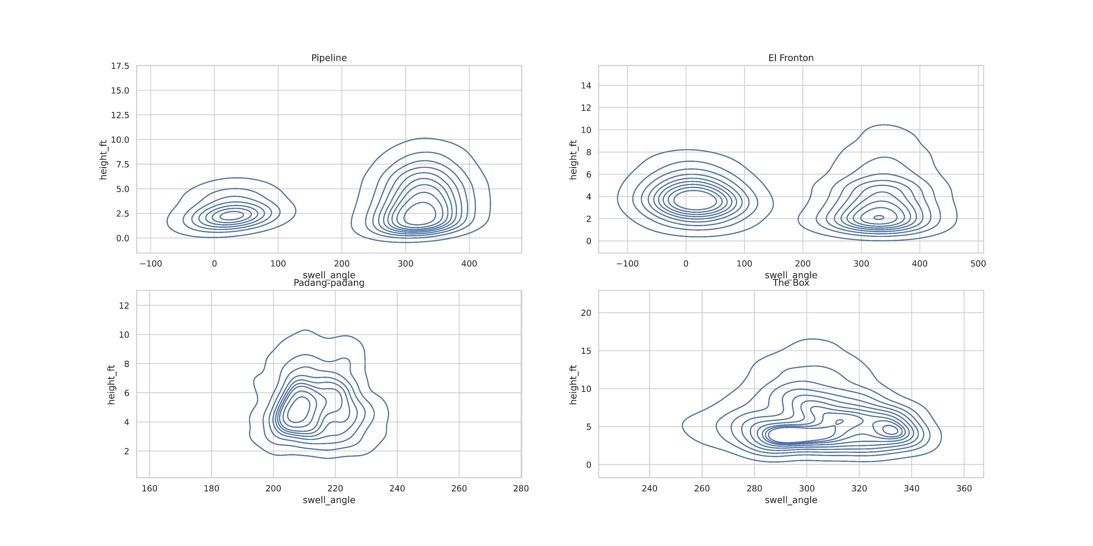
Wave density

Slide 12
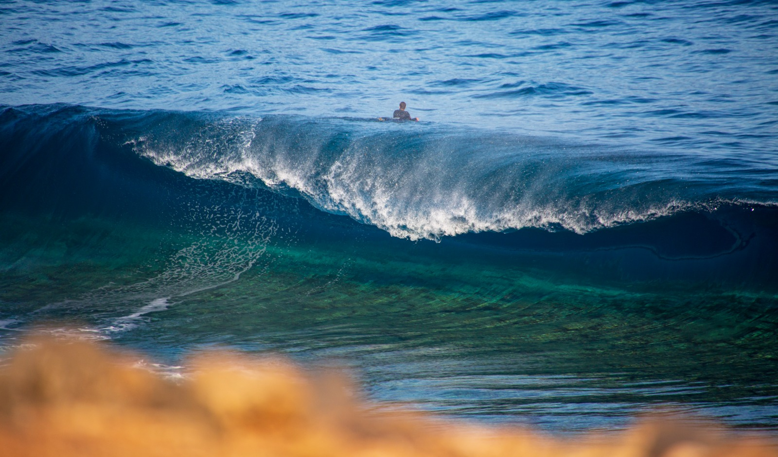
What does the platform do?
The basic function of this platform is to produce pre-trained via ML predictions of the conditions for the date choosen by the user and to recommend them to the best spot at that moment in time.

Slide 13
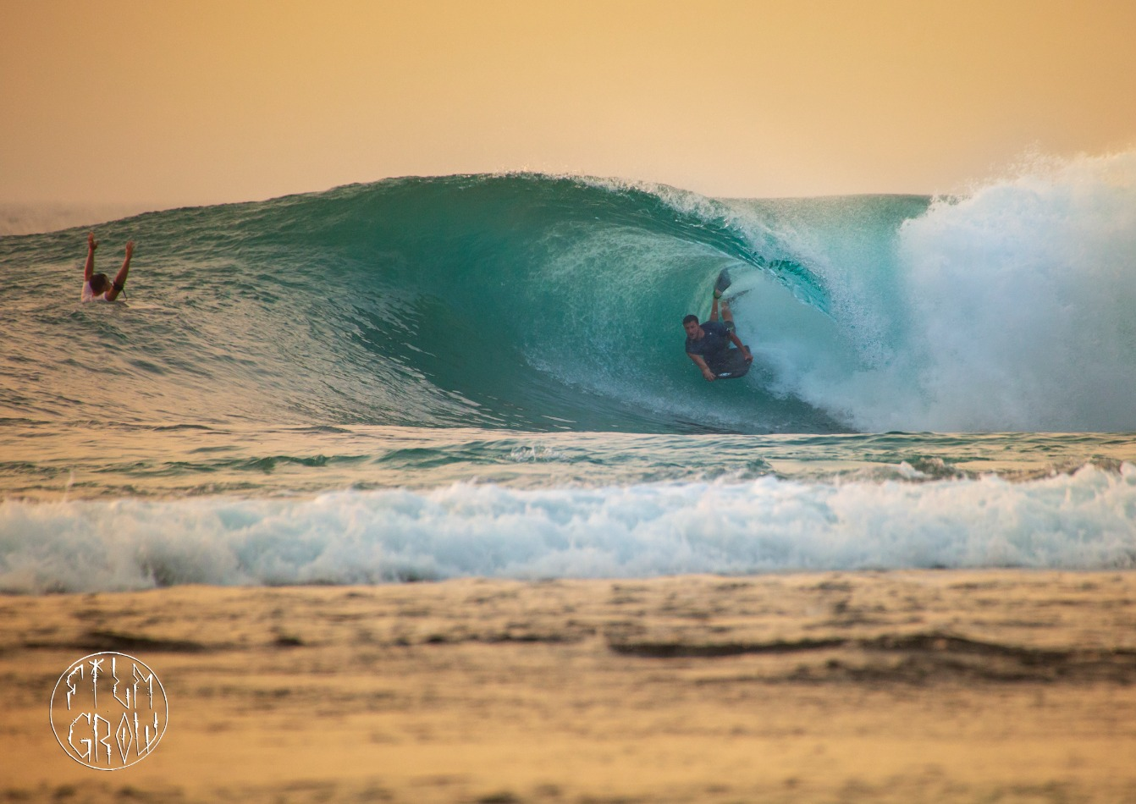
Technologies used
Selenium
Streamlit
Pandas
Numpy
Statsmodels(ARMA)
FBProphet
Matplotlib
Seaborn
Plotly express

Slide 14
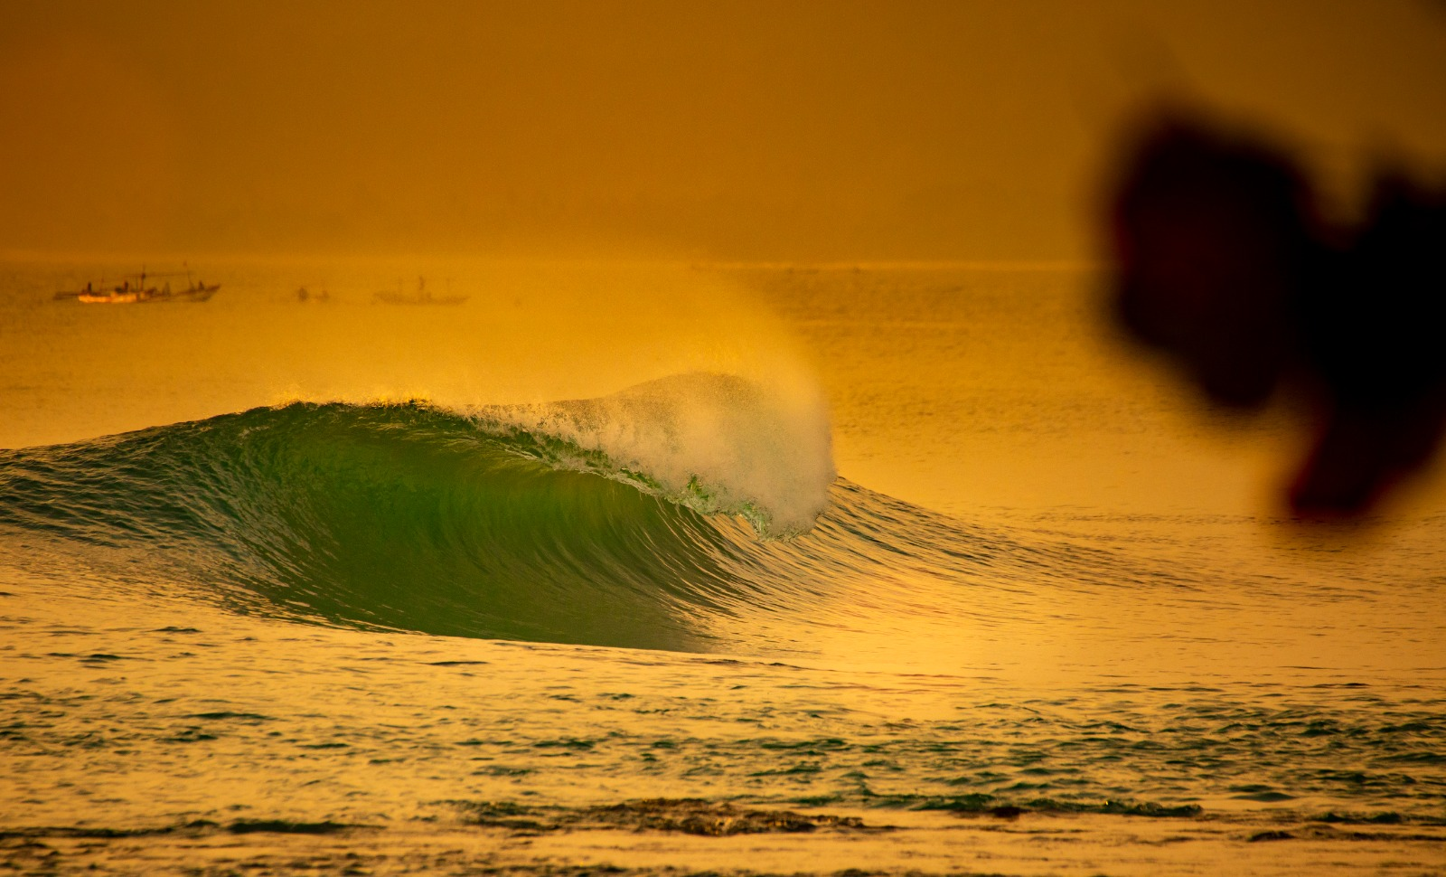
To do
Add a travel platform to be able to offer the best routes to the recommended spots.
Add an accomodation option, to also be able to offer a place stay for you next surf trip!
Add tide tables .

Slide 15

Thanks to
Ironhack
Ras
Ana
Sheriff
Tony Cruz @filmgrow

